Slide 1

EXPLORING advanced IMAGE EDITING TECHNIQUES : A COMPREHENSIVE STUDY OF DIFFUSER MODELS FOR ENHANCED VISUAL IMPACT
ECE 570000 – FINAL PROJECT PRESENTATION
Parth R. Doshi
Notes:
My name is Parth Doshi and my ECE 570 project is titled: Exploring Advanced Image Editing Techniques.

Slide 2
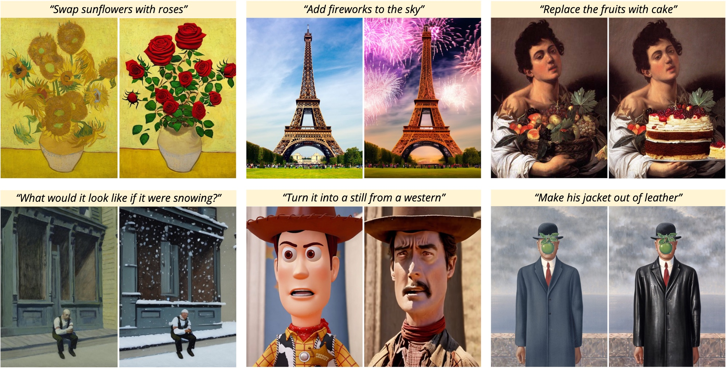
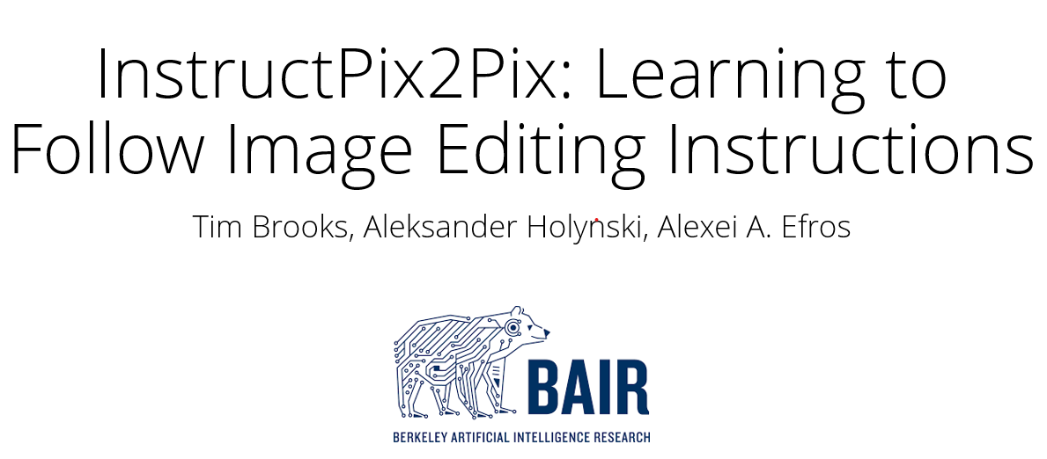

INSTRUCTPIX2PIX (IP2P)
IMAGE EDITING BASED DIFFUSION MODEL
Notes:
This project is based on the image editing diffusion model: InstructPix2Pix by Tim Brooks et al.
Given an input image and a text-based instruction, IP2P outputs a modified image.

Slide 3
IMPLEMENTATION MOTIVATION
Robotic systems today have become exponentially advanced
Fully and completely automate tasks performed by AI
Eliminate the need of a human source for modern machine learning model verification
Revolutionize modern AI task validation
Notes:
Modern machine learning models can solve specific downstream tasks to a high level of performance today. While this capability has been demonstrated in other fields of AI it remains to be shown in robotics.
Therefore, Google developed RT-1, a robotic learning system that absorbs data and effectively generalizes. It uses a robot arm that performs a task given a natural language processing instruction.
My implementation motivation is based on the ability to automate verifying tasks performed by AI, using AI. In other words, if IP2P can verify whether a task is performed as expected, the need for a human source is eliminated.

Slide 4
IMPLEMENTATION GOALS
1. Construct a relationship between image and text guidance scale parameters used by IP2P
2. Evaluate the effectiveness of InstructPix2Pix using a carefully curated dataset from Google’s RT-1 using data processing techniques
3. Fine-tune IP2P to produce nearly accurate results as Google’s RT-1 using a training function
Notes:
My preliminary implementation involves varying image/text guidance inputs provided to IP2P and observing the changes in the output image.
To add a layer of complexity, my extended implementation uses a curated dataset from Google’s RT-1.
I use an episodeby dividing it into image frames. The first image frame is used as an input image and the final frame is used as an expected output image.
To verify the accuracy of the result, a loss function and training function is implemented that would fine-tune and train IP2P to provide the desired result with a negligible MSE loss.

Slide 5
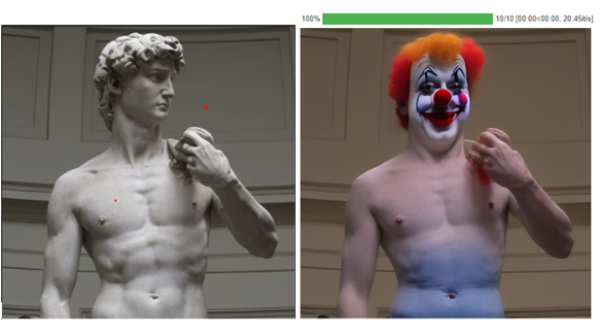
RESULTS - PRELIMINARY EXPERIMENTS
“make him into a clown”
Notes:
My code adapts the implementation of IP2P and uses Google Collaboratory to compile and execute.
The left image is the input to the model along with the prompt (human-written instruction) : ”make him into a clown,”
and on the right we see how InstructPix2Pix successfully transforms the image into that of a clown.

Slide 6
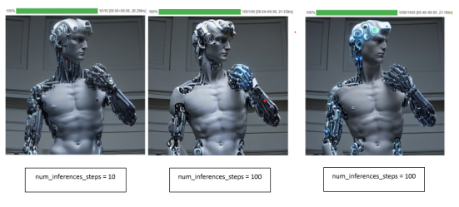
RESULTS - PRELIMINARY EXPERIMENTS
CLAIM :
Increasing the number of inference steps should improve the quality and detail of generated images.
EVIDENCE :
Notes:
I used the same image of a human statue as an input, and an instruction that makes him into a cyborg, and varied the number of inference steps. This gives me an image closer to that of a cyborg but also extends the time it takes to produce these images.

Slide 7
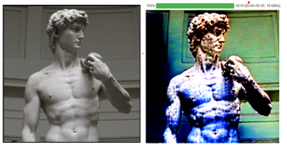
RESULTS - PRELIMINARY EXPERIMENTS
CLAIM :
A higher image guidance scale would disregard the context of the image and simply try to enhance features of a cyborg.
EVIDENCE :
Image guidance scale = 10
Notes:
Next, I implemented an image guidance scale and adjusted it to see how the output changes. The image guidance scale primarily tells the model to what extent should it consider the prompt.
Increasing this causes the model to generate an output image using metal colors like blue and silver disregarding the actual context.

Slide 8
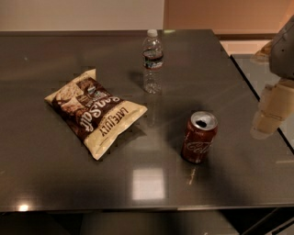
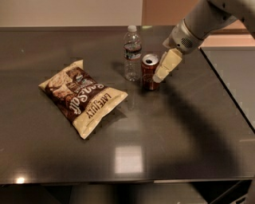
EXAMPLE - EXTENDED EXPERIMENT
INPUT
EXPECTED OUTPUT
InstructPix2Pix
“Move coke can near water bottle”
Notes:
As an extension, a curated dataset with image-text pairs are input into the model. The results are then verified with the expected ouput.
If RT-1 is prompted to ” Move coke can near water bottle” and it successfully completes the task.
Given an image of a coke can, water bottle and a packet of chips with the same text prompt, IP2P should be able to provide an output image that perfectly matches the completion of the task by the robot.

Slide 9
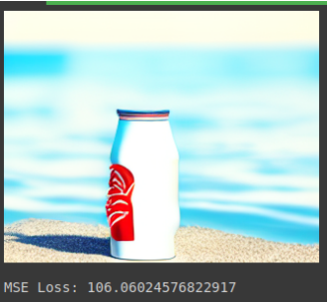
RESULTS - EXTENDED EXPERIMENT
INPUT
ACTUAL OUTPUT
InstructPix2Pix
“Move coke can near water bottle”
Notes:
When passed through IP2P the output clearly does not match the expected output. While IP2P retains the words “coke can”, “water” and “near”. It is unable to gauge a proper context.
After performing extensive data processing, including an implementation of a loss function that uses prompt conditioning, the results show an MSE Loss of 106.06 which is extremely high and undesirable.

Slide 10
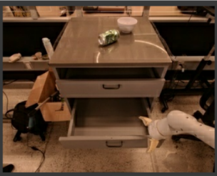
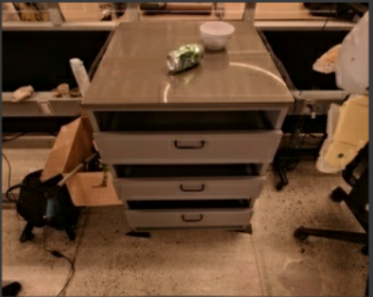
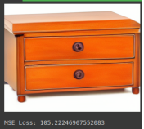
RESULTS - EXTENDED EXPERIMENT
EXPECTED OUTPUT
INPUT
ACTUAL OUTPUT
InstructPix2Pix
“Open middle drawer”
Notes:
A similar experiment with the input image of a series of drawer is shown here.
Given a prompt to ” Open a middle drawer” IP2P produces an image that comptelely eliminates the middle drawer which does not match the expected output, with an MSE loss of 105.224.

Slide 11
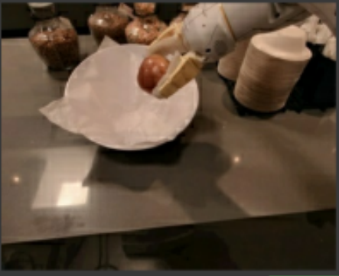
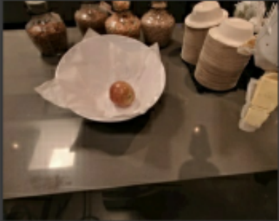
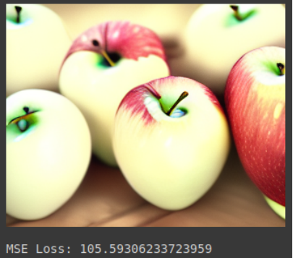
RESULTS - EXTENDED EXPERIMENT
EXPECTED OUTPUT
INPUT
ACTUAL OUTPUT
InstructPix2Pix
“Pick apple from white bowl”
Notes:
The experiments are run on 150 difference episodes across 3 datasets. This slide shows another example of the extended experiment.
After processing results, we obtain an average MSE loss of 105.54 which mean that the output and expected output image have significant differences.

Slide 12
TRAINING IP2P
Modified Dataset
Encoder
Decoder
Notes:
Therefore, to obtain better results, I thought of training IP2P on a modified dataset that I obtained from scratch. The implemented training function uses autoencoders and decoders to perform the training.
However, to run this function and retrain IP2P currently, the process can be concluded as computationally intensive and expensive and can be an extension to future research.

Slide 13
CONCLUSIONS
IP2P excels in generating a diverse array of captivating image edits, encompassing style, medium and contextual alterations
The quality of the generated images is constrained by the visual fidelity of the imagery produced, dictated by the diffusion parameters
It requires human-in-the-loop reinforcement learning to imitate RT-1’s functionality
IP2P is unable to identify individual objects within an image
IP2P struggles with spatial reasoning and object count identifications
Training a image editing diffusion model like IP2P is computationally complex and expensive
Notes:
To conclude, IP2P successfully edits images that do not require much spatial and object identification. For tasks and actions performed by that of a robotic learning system it is inefficient to evaluate the effectiveness using image verifying diffusion models. After rerunning and extending experiments by IP2P on personally generated datasets it can be concluded that running experiments using datasets that the model is not trained on, is a key factor in evaluating the effectiveness of the model. Training an image editing diffusion model like IP2P is computationally complex and expensive. Image editing diffusion models currently are not as developed to perform modifications that humans require yet.

Slide 14
REFERENCES
Brooks, T., Holynski, A., and Efros, A. A. Instructpix2pix: Learning to follow image editing instructions. 2023 IEEE/CVF Conference on Computer Vision and Pattern Recognition (CVPR), pp. 18392–18402, 2022. URL https://api. semanticscholar.org/CorpusID:253581213.
Brohan, A., Brown, N., Carbajal, J., Chebotar, Y., Dabis, J., Finn, C., Gopalakrishnan, K., Hausman, K., Herzog, A., Hsu, J., Ibarz, J., Ichter, B., Irpan, A., Jackson, T., Jesmonth, S., Joshi, N. J., Julian, R. C., Kalashnikov, D., Kuang, Y., Leal, I., Lee, K.-H., Levine, S., Lu, Y., Malla, U., Manjunath, D., Mordatch, I., Nachum, O., Parada, C., Peralta, J., Perez, E., Pertsch, K., Quiambao, J., Rao, K., Ryoo, M. S., Salazar, G., Sanketi, P. R., Sayed, K., Singh, J., Sontakke, S. A., Stone, A., Tan, C., Tran, H., Vanhoucke, V., Vega, S., Vuong, Q. H., Xia, F., Xiao, T., Xu, P., Xu, S., Yu, T., and Zitkovich, B. Rt-1: Robotics transformer for real-world control at scale. ArXiv, abs/2212.06817, 2022. URL https://api.semanticscholar.org/ CorpusID:254591260.
Notes:
Thank you.

